Slide 1
Kisan Mandi
Farmer’s Market

Slide 2
Agenda
Problem Statement
Solution to the problem
Who is Benefited?
System Architecture
Key points about the portal
Technology Stack

Slide 3
Problem Statement
India is an agricultural country and one third population depends on the agricultural sector directly or indirectly. As food being essential need of mankind, much emphasis has been on commercialising agricultural production.
Agricultural marketing is mainly the buying and selling of agricultural products. In earlier days when the village economy was more or less self-sufficient the marketing of agricultural products presented no difficulty as the farmer sold his produce to the consumer on a cash or barter basis.
Today's agricultural marketing has to undergo a series of exchanges or transfers from one person to another before it reaches the consumer. There are three marketing functions involved in this, that are;
• assembling
• preparation for consumption
• distribution
Products are sold in various ways. For example, it might be sold at a weekly village market in the farmer's village or in a neighbouring village. If these outlets are not available, then produce might be sold at irregularly held markets in a nearby village or town, or in the Mandi.
Importance of Agriculture Marketing
Agricultural products are perishable; therefore, a failure to sell on time results in wasted harvest. All wasted harvest represents a cost of land, water, labor, storage - and no income to show for it.
Agricultural prices can be quite variable, impacted by changes in weather and harvests in far corners of the world.
Farmers seek higher prices for their produce, and protection from price fluctuations. They may also work to open up new markets or channels, such as selling directly to consumers instead of through producers.

Slide 4
Problem Statement ..
Interests of Farmers, Manufacturers, Traders and Consumers in Agriculture
Marketing System
The farmer's interest is focused on getting the best return from his produce, which usually equates to maximum price for unlimited quantities.
Vendors and retailers want high quality and reliable supplies from the farmer, at the most competitive prices.
Consumers are interested in obtaining high quality products at low prices. Clearly, there are conflicting interests here.
All the above points will be addressed with the farmer portal that we will be building in this presentation

Slide 5
Solution to the problem statement
We will be building a portal where in farmer can sell his own crop directly to consumers / local vendors with the price they want to sell without any middle men or producers. Few of the benefits that can be achieved with this portal are listed below
Consumers/vendors will receive quality product in reasonable price directly from farmer
Organic farming will be looked up on
Farmers will not be in financial crisis to large extent

Slide 6
Who is benefited
Consumer/Vendor → Will receive quality product in reasonable price directly from farmer
Farmer → Will be able to sell his crop at his own price and be happy for getting the profit
Government → Will be benefited by improvement in agriculture sector to some extent and also will be in a position to look up on to organic farming to large extent

Slide 7
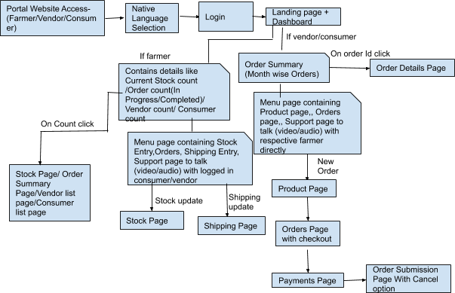
System Architecture
Notes:
* For Aadhar based login user should input the OTP received to his registered mobile number
* For fingerprint based login we will be using open source based fingerprint SDK/Biometric SDK
* For payment page we will be using stripe framework
* For Video calling/ Audio calling we will be using WEBRTC framework

Slide 8
Key points about the portal
Portal will have both biometric as well as Aadhar based login options to the user. User can choose either of them to login to the system
Order cannot be cancelled after the product is in shipping state
Portal has three roles -> Consumer / Vendor / Farmer
Customer support page will have a small comments section which can be used to provide feedback which will make the farmer happy and willingness to provide quality product always

Slide 9
Technology Stack
Node JS
Express JS
MongoDB
Stripe Framework
Socket IO and WebRTC frameworks

